Slide 1
Telecom Billing System
Submitted by:
Name & Reg. No: Manas Singhal (RA2111003011881)
Name & Reg. No: Hardik Chhipa (RA2111003011890)
Name & Reg. No: Janenie J (RA211100301894)
Branch: CSE CORE
Section: Z2

Slide 2
Table of contents
1.Introduction
2.Abstract
3.Features
4.Flowchart
5.Execution
6.Benefits
7.Conclusion

Slide 3
INTRODUCTION
The Telecom industry has been experiencing tremendous growth for some time now. However, this growth comes with some challenges. The best part is: that many of these challenges can be easily solved by telecom billing software. During the previous few years that the billing system has received significance equivalent to other aspects of the telecom sector. Billing solution providers globally have continually added numerous structures to their solutions to ensure both consumers and telecom operators do not face any billing-related concerns.

Slide 4
ABSTRACT
This project deals with the idea of developing the mini project of a telecom management system in c programming language. this project covers all the basic c programming concepts like conditional statements, loops, switch cases, etc.it contains various features:
Registration or adding new records
Viewing the existing records
Changing information or modifying records
Searching records
Payment option

Slide 5
FEATURES
This project is to create an online telecom billing system. On running the C program, one will be directed to the Telecom Billing system’s main menu:
1. For Adding new Records.
2. For listing records .
3. For Modifying records .
4. For Payments.
5. For searching Records.
6. For deleting records .
7. For exit On choosing any one of the above options, the user will be able to perform the desired action. The interface is extremely user-friendly.

Slide 6
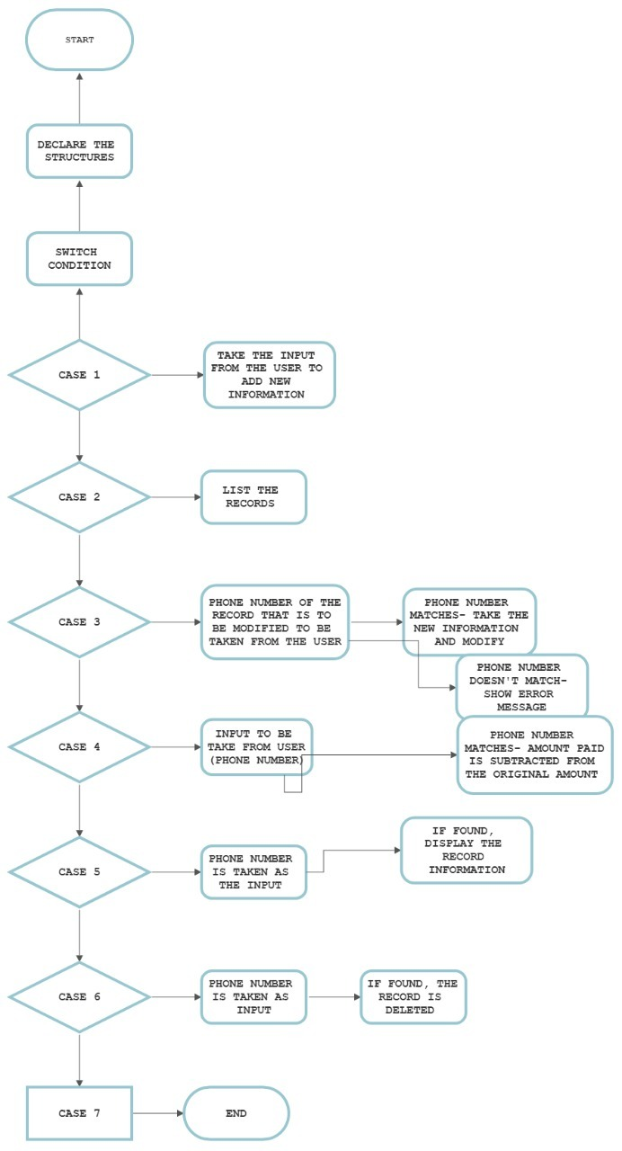
FLOWCHART

Slide 7
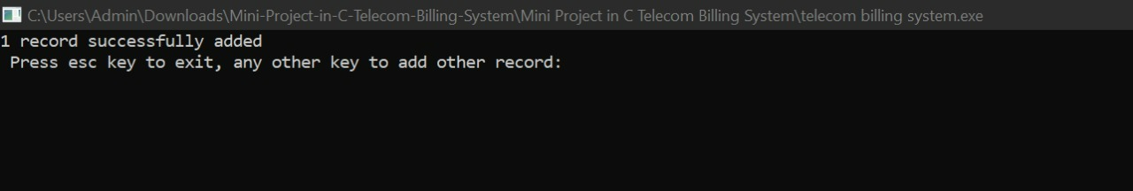
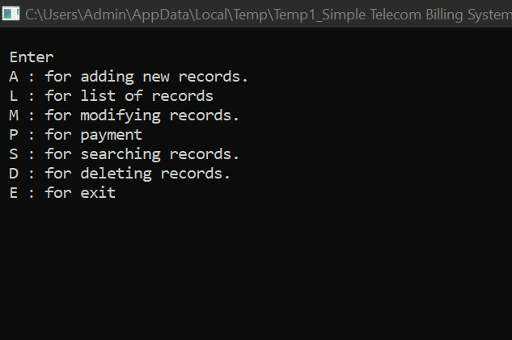
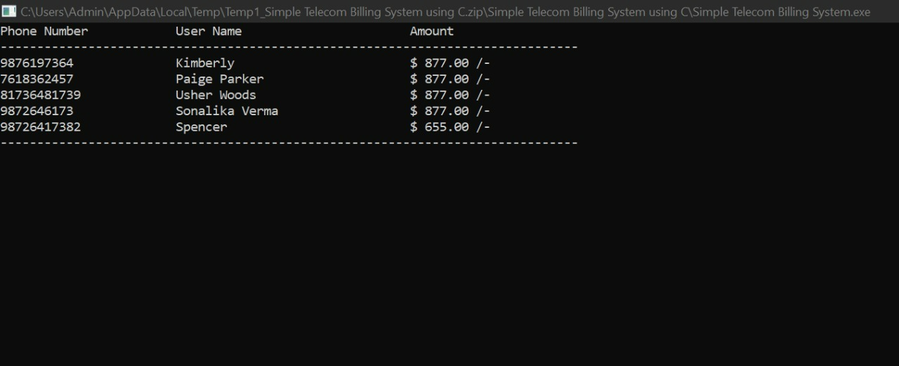
For Adding Records
MENU
Listing Records

Slide 8
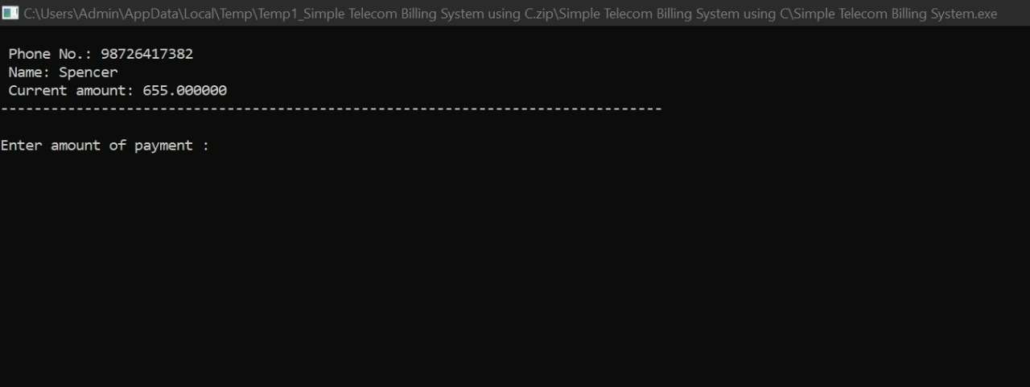
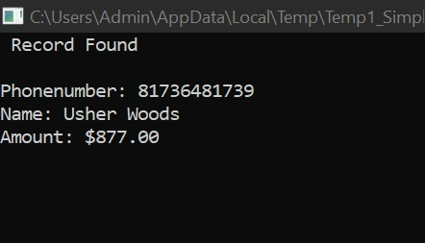
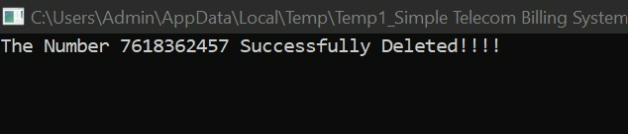
For Payment
For searching Records
For Deleting Records

Slide 9
BENEFITS
1. Reducing faults associated with billing .
2. Screening of matching records.
3. Availability of detailed bill.
4. Dealing With Innumerable Customers And Payments.
5. Timely Management of Subscriptions .
6. Customer Data Safety.

Slide 10
COCLUSION
We have obtained a Menu driven program in C to operate a user-friendly Telecom Billing system. Thus, with the same logic, many more features can be added to the system to nurture the needs of the user in various other ways, and to enable additional user workspace by using more functionalities.

